Slide 1





Larana Inc.
GLOBAL ELECTRONIC RETAIL DASHBOARD
Key metrics and insights to guide our business forward in June 2025
Presentation 2025

Slide 2


MEET
OUR TEAM
AHMED ABDELHAMEED
YAHIA EMAD ELDIN
AHMED SHAARAWY
MOHAMED YAHIA
MOHAMED OSAMA

Slide 3

Table of Content
In this session, we will review key performance areas, explore user trends, and discuss next steps to support business growth.
Executive Summary
01
Sales by Category
05
Project Purpose
02
Sales by Country
06
Key Performance Indicators
03
Product Performance
07
Sales & Profit Trend
04
Conclusion & Recommendations
10

Slide 4





Larana Inc.
Executive Summary
This project presents a complete business performance dashboard designed for a global electronic retailer.
The dashboard provides clear insights into sales, profit, product performance, customer behavior, and geographic trends.
Our goal is to help management make faster, more informed, and data-driven decisions
using a clean and interactive reporting tool.

Slide 5


PROJECT PURPOSE
The purpose of this project is to build a dashboard that summarizes the company’s overall
performance in a simple and visual way.
We focused on four main areas:
• Sales and profit trends
• Product-level performance
• Customer and store insights
• Geographic performance
The dashboard supports decision-makers by identifying strengths, weaknesses, and
opportunities for improvement.

Slide 6
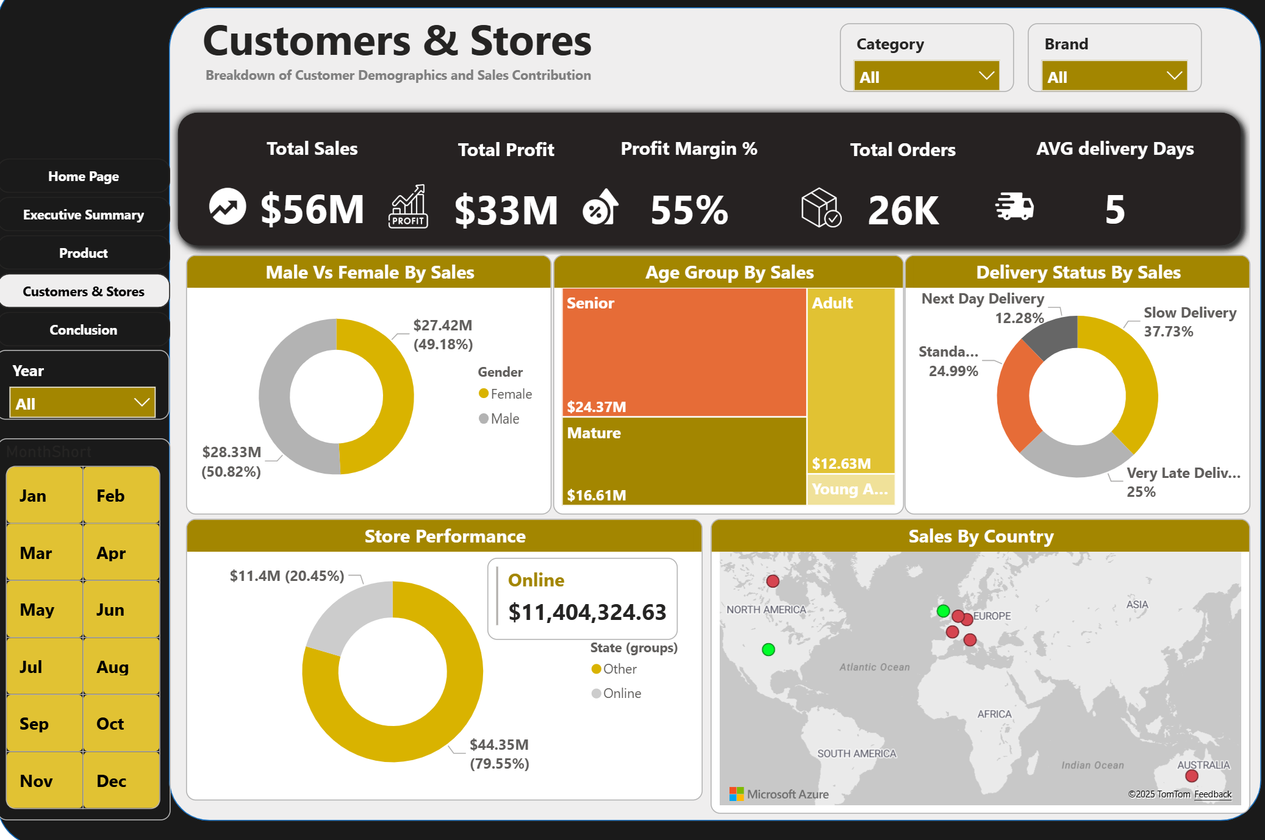
Key Performance Indicators
The KPI section provides a quick view of the business health:
• Total Sales: $56M
• Total Profit: $33M
• Profit Margin: 55%
• Total Orders: 26K
• Average Delivery Time: 5 days
These KPIs show solid financial performance, strong demand, and efficient operations.

Slide 7
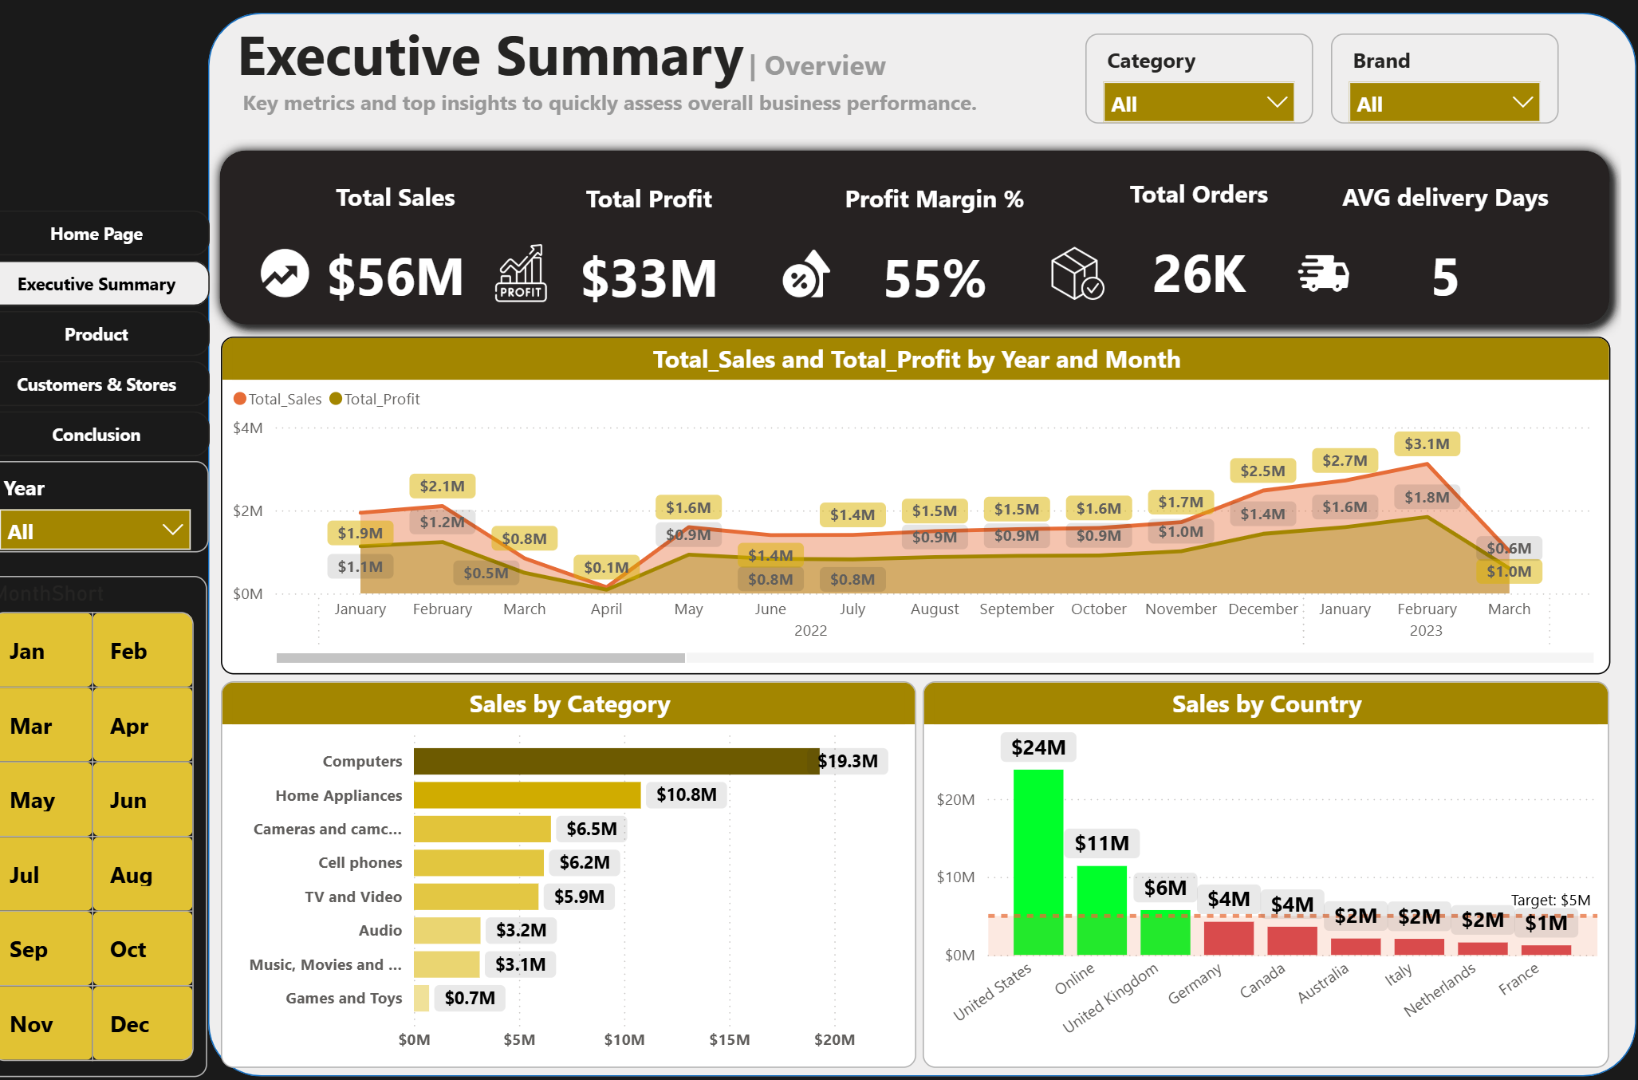
Sales & Profit Trend
the trend analysis shows monthly changes in sales and profit.
We observed seasonal peaks and dips, with profit closely following sales.
This indicates strong cost control and consistent profitability.
The rising trend in recent months suggests potential for further growth

Slide 8

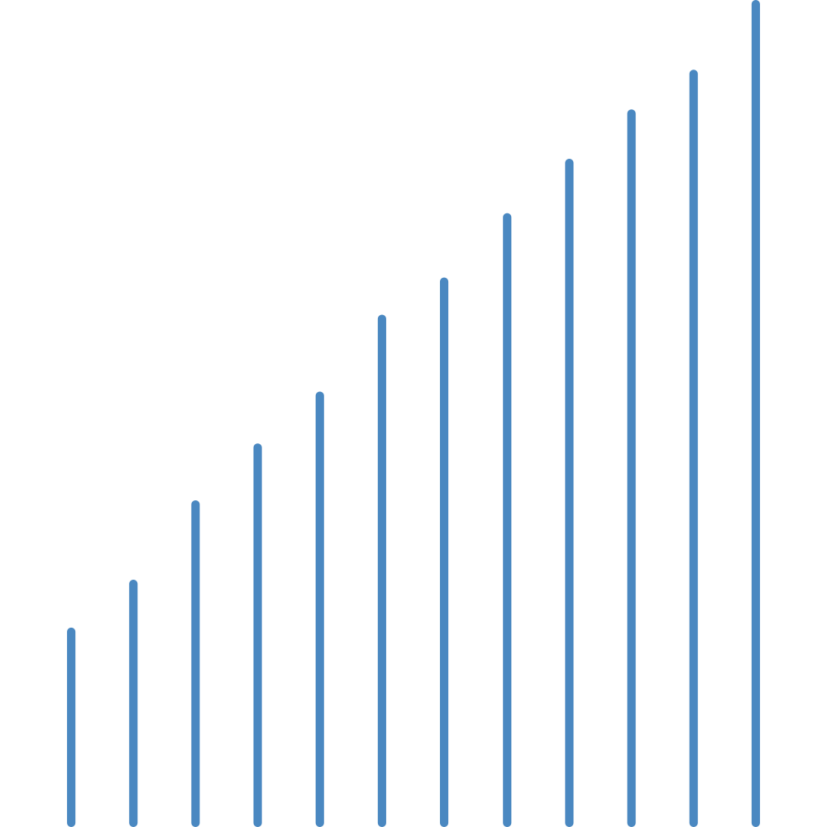

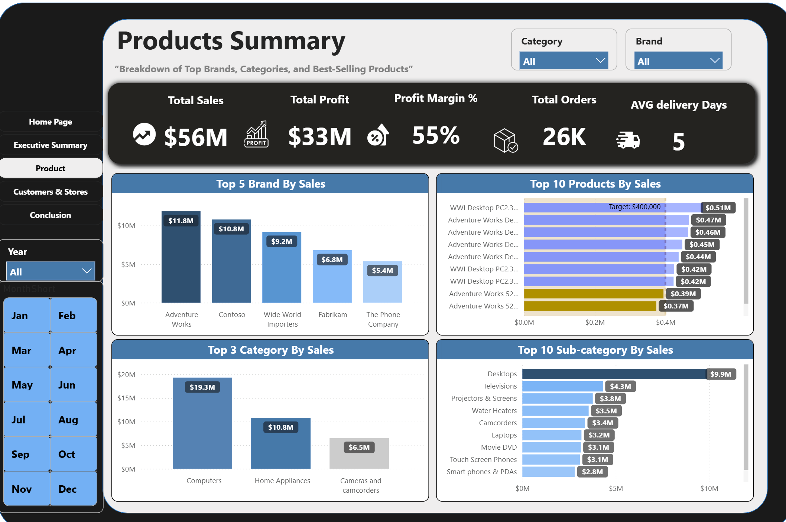
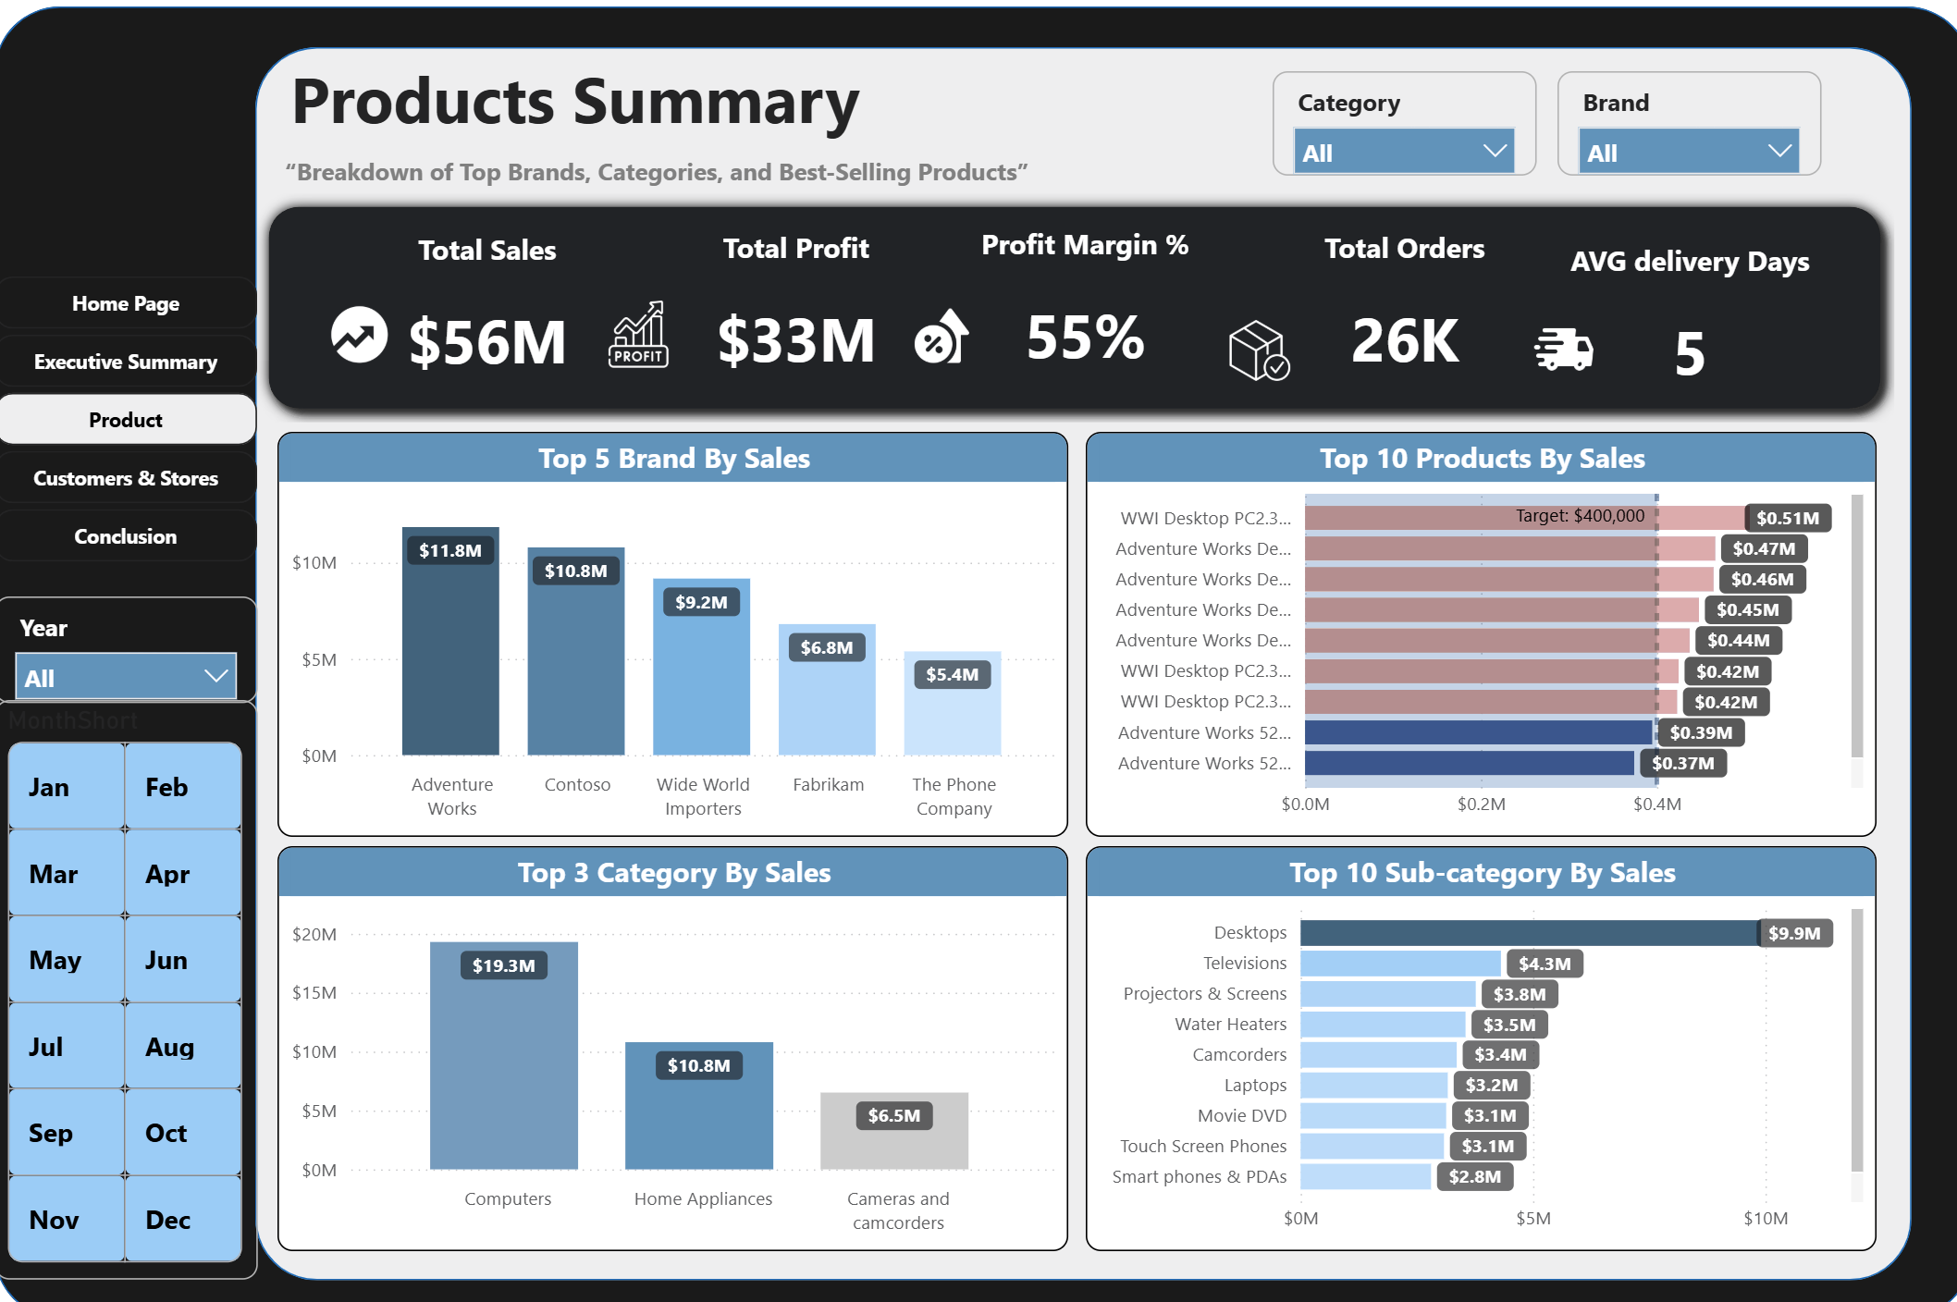
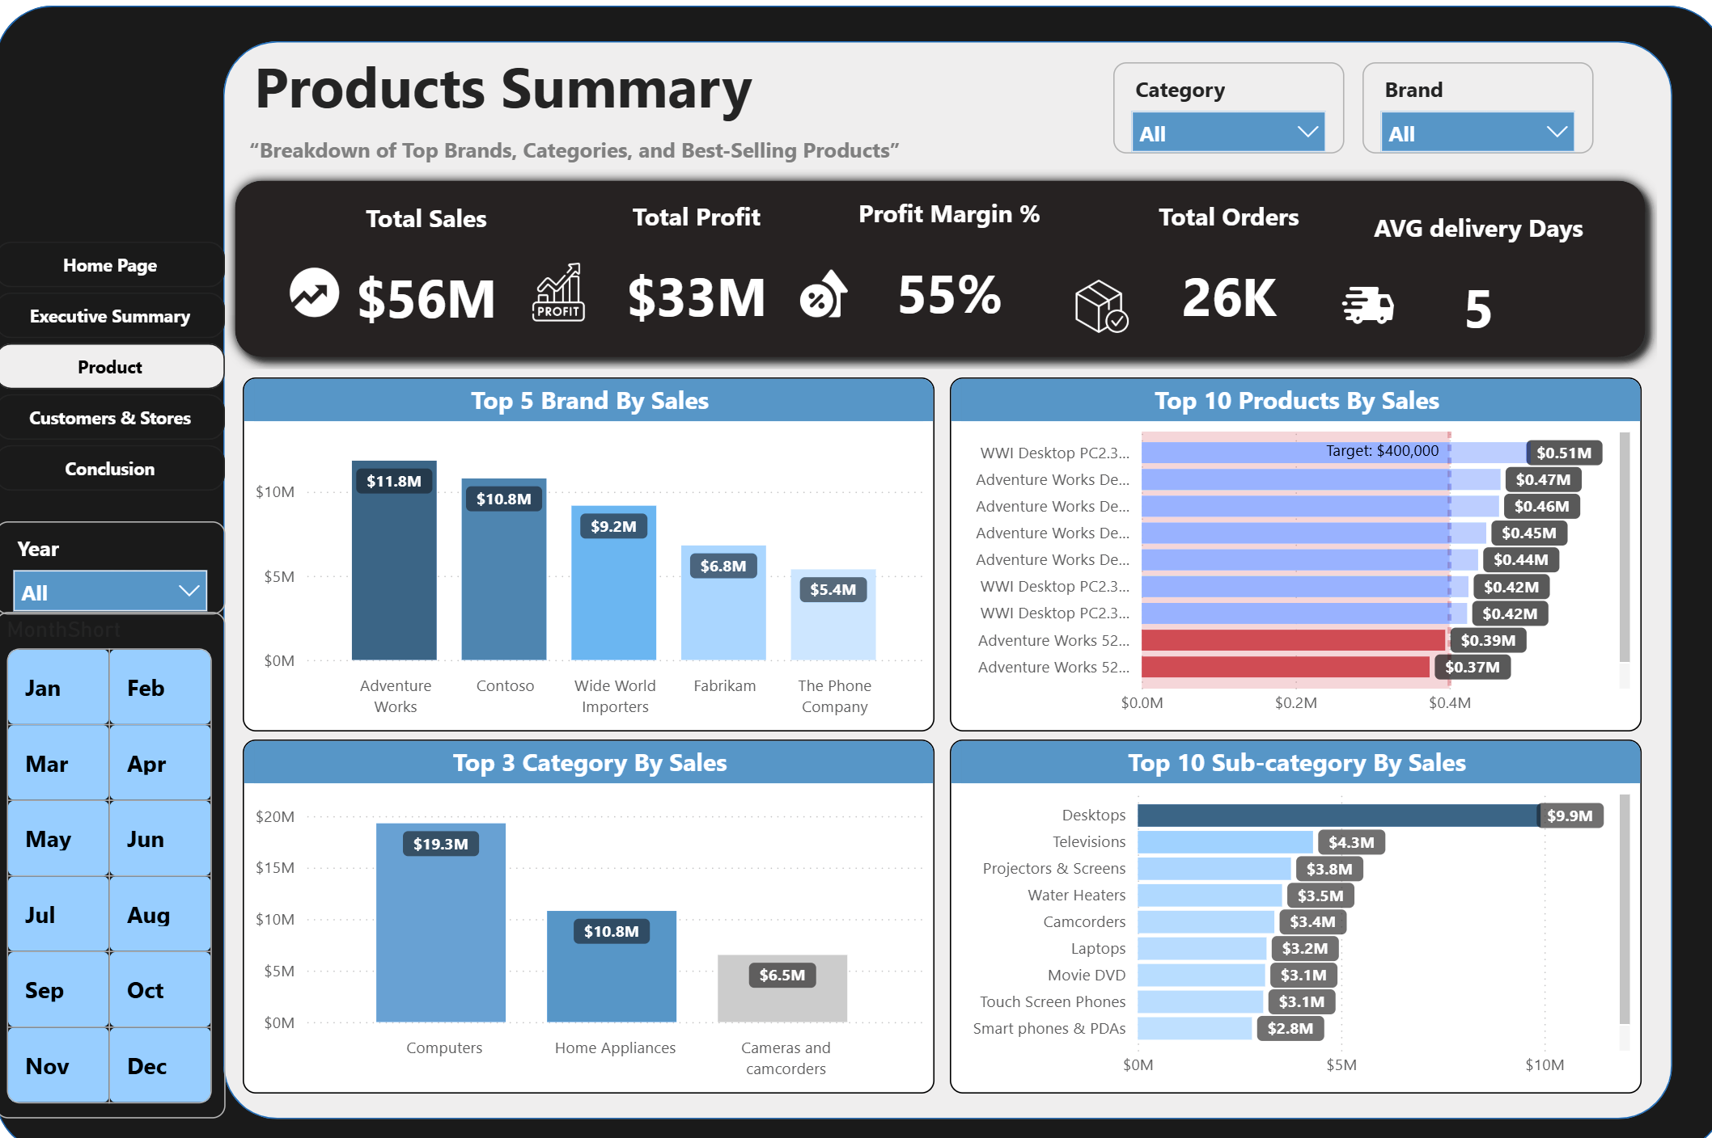

Total Sales
When looking at product categories, Computers drive the highest sales with a significant gap.
Home Appliances and Cameras also contribute well but remain lower.
This breakdown helps the company understand which product categories lead revenue
and where to focus marketing or inventory planning.

Slide 9
Total Sales
The geographic breakdown shows the United States as the strongest market with around
$24M in sales.
Online sales also contribute heavily, reaching $11M.
The United Kingdom, Germany, and Canada show stable mid-level performance.
Countries like Italy and France show lower sales, indicating areas for market improvement
or targeted strategies

Slide 10


Customer analysis shows sales almost evenly split between male and female customers.
Senior and Adult age groups generate the highest sales.
Most deliveries are on time, but improvements are needed for slow and very late deliveries.

Slide 11
Larana Inc.
Conclusion & Recommendations
Overall, the dashboard shows strong business performance supported by high demand products, loyal customer segments, and strong geographic markets.
We provide three main recommendations:
1. Strengthen focus on top-performing product lines, especially desktops and computer-related items.
2. Increase investment in high-performing markets and online channels.
3. Improve delivery operations to reduce delays and enhance customer satisfaction.
This dashboard gives the company a powerful foundation for strategic decision-making and future planning.

Slide 12





Larana Inc.
CLOSING & Q&A
Thank you for your attention and participation throughout this presentation

